Slide 1

Class 3: Finding Data
Digital frameworks
Northwestern University – Spring 2020
Github.com/randyleonard99/digitalframeworks-spring2020

Slide 2
Data stories?

Slide 3
Steps to a data story
Find data/have an idea
Clean data
Analyze data
Present data

Slide 4

Learning as we go

Slide 5

Learning as we go

Slide 6


Learning as we go
What do reporters do when the shaking stops?

Slide 7
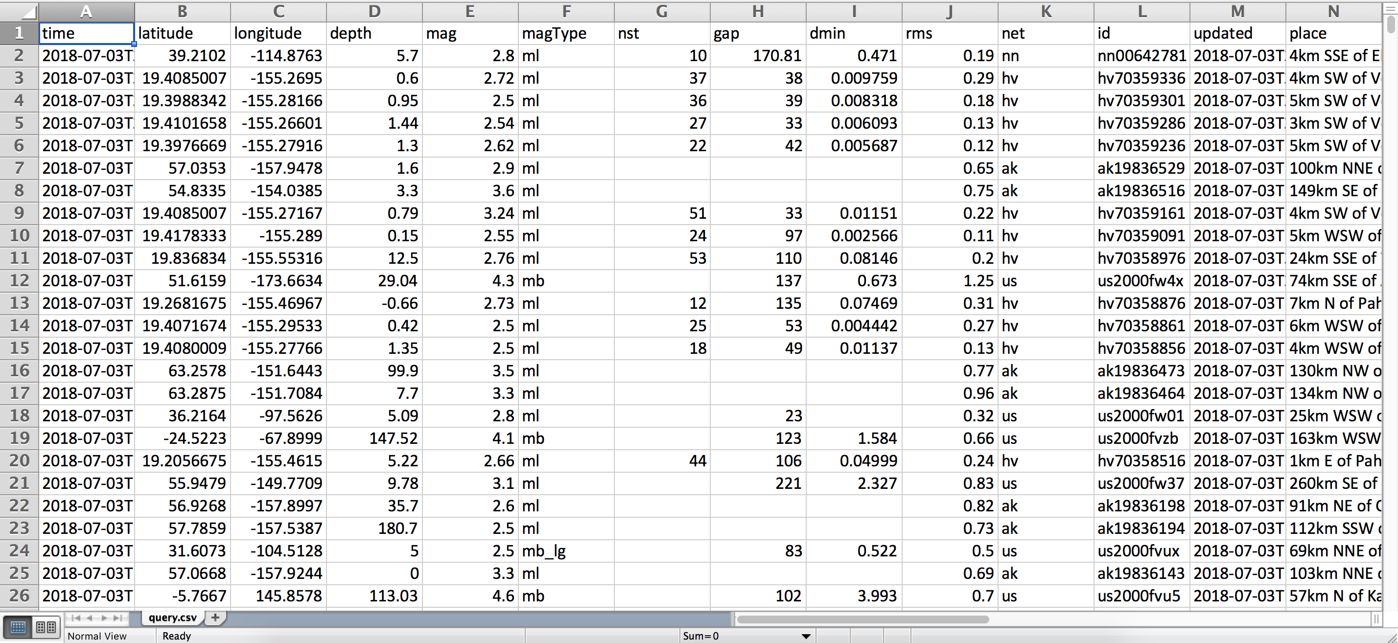
Learning as we go
What do reporters do when the shaking stops?

Slide 8
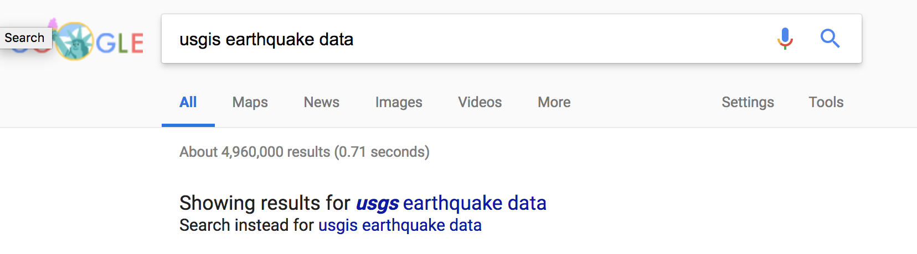
Learning as we go

Slide 9
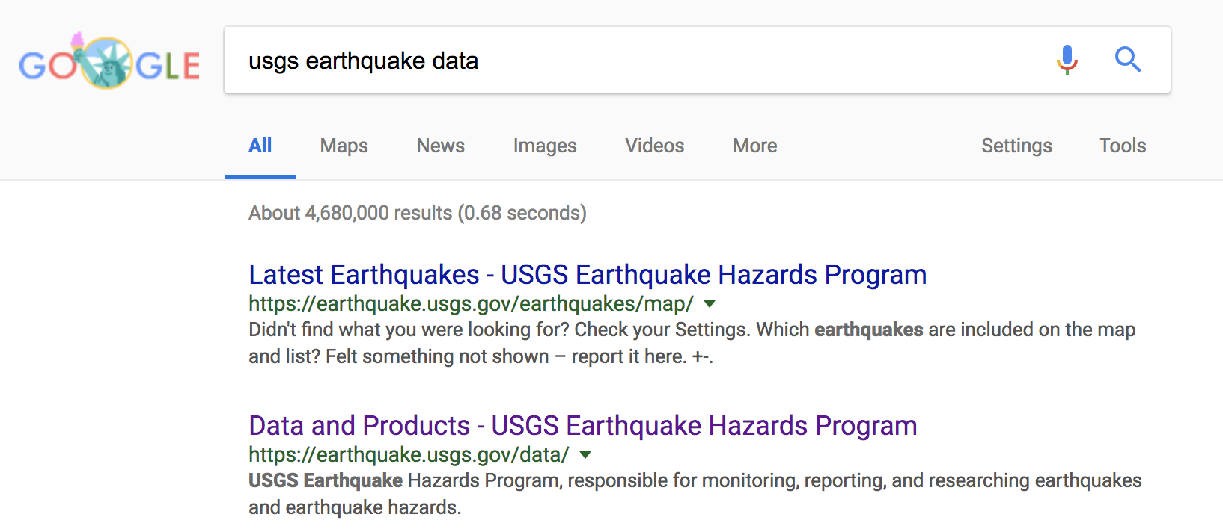
Learning as we go

Slide 10
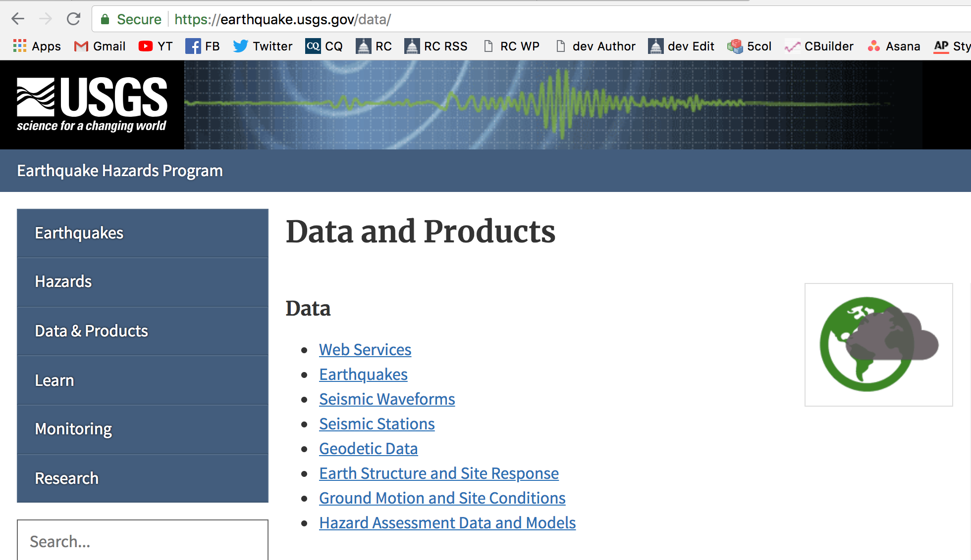
Learning as we go
What do reporters do when the shaking stops?

Slide 11
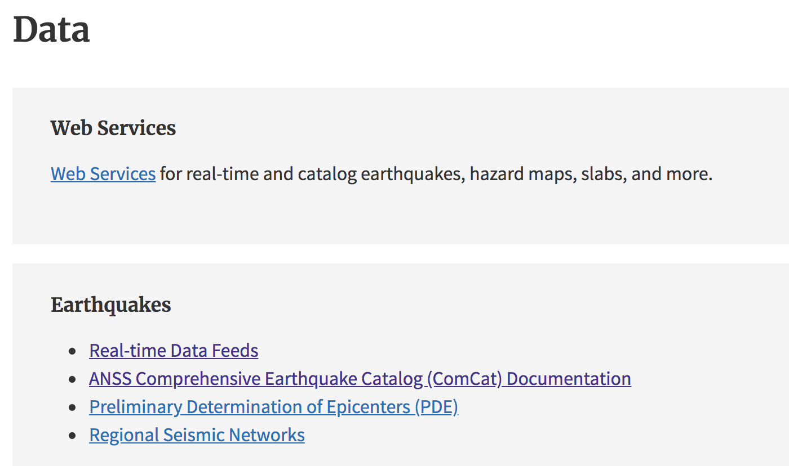
Learning as we go

Slide 12
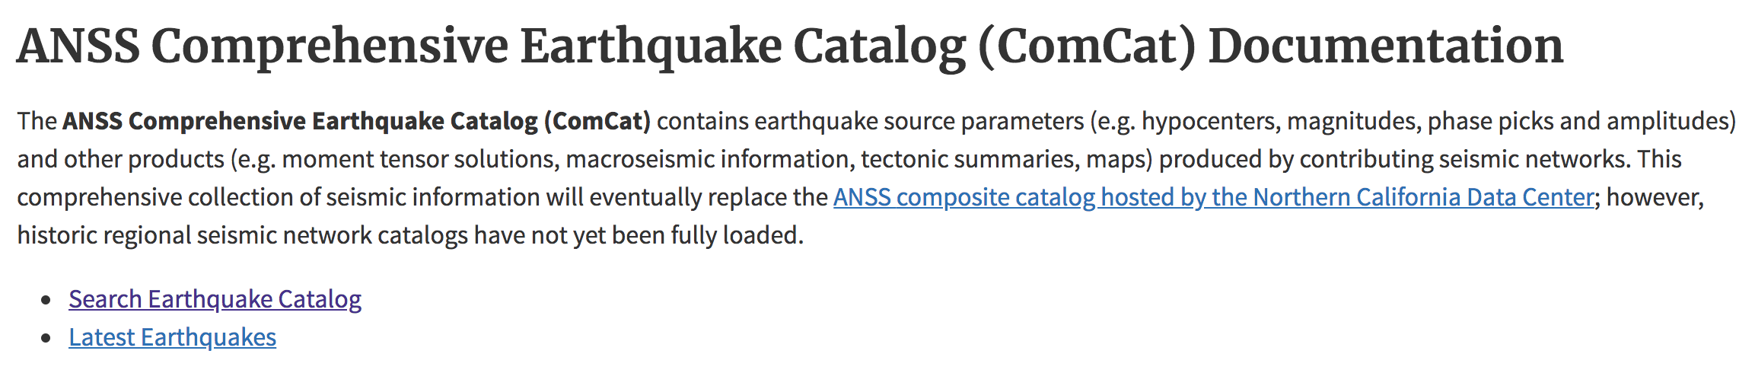
Learning as we go

Slide 13
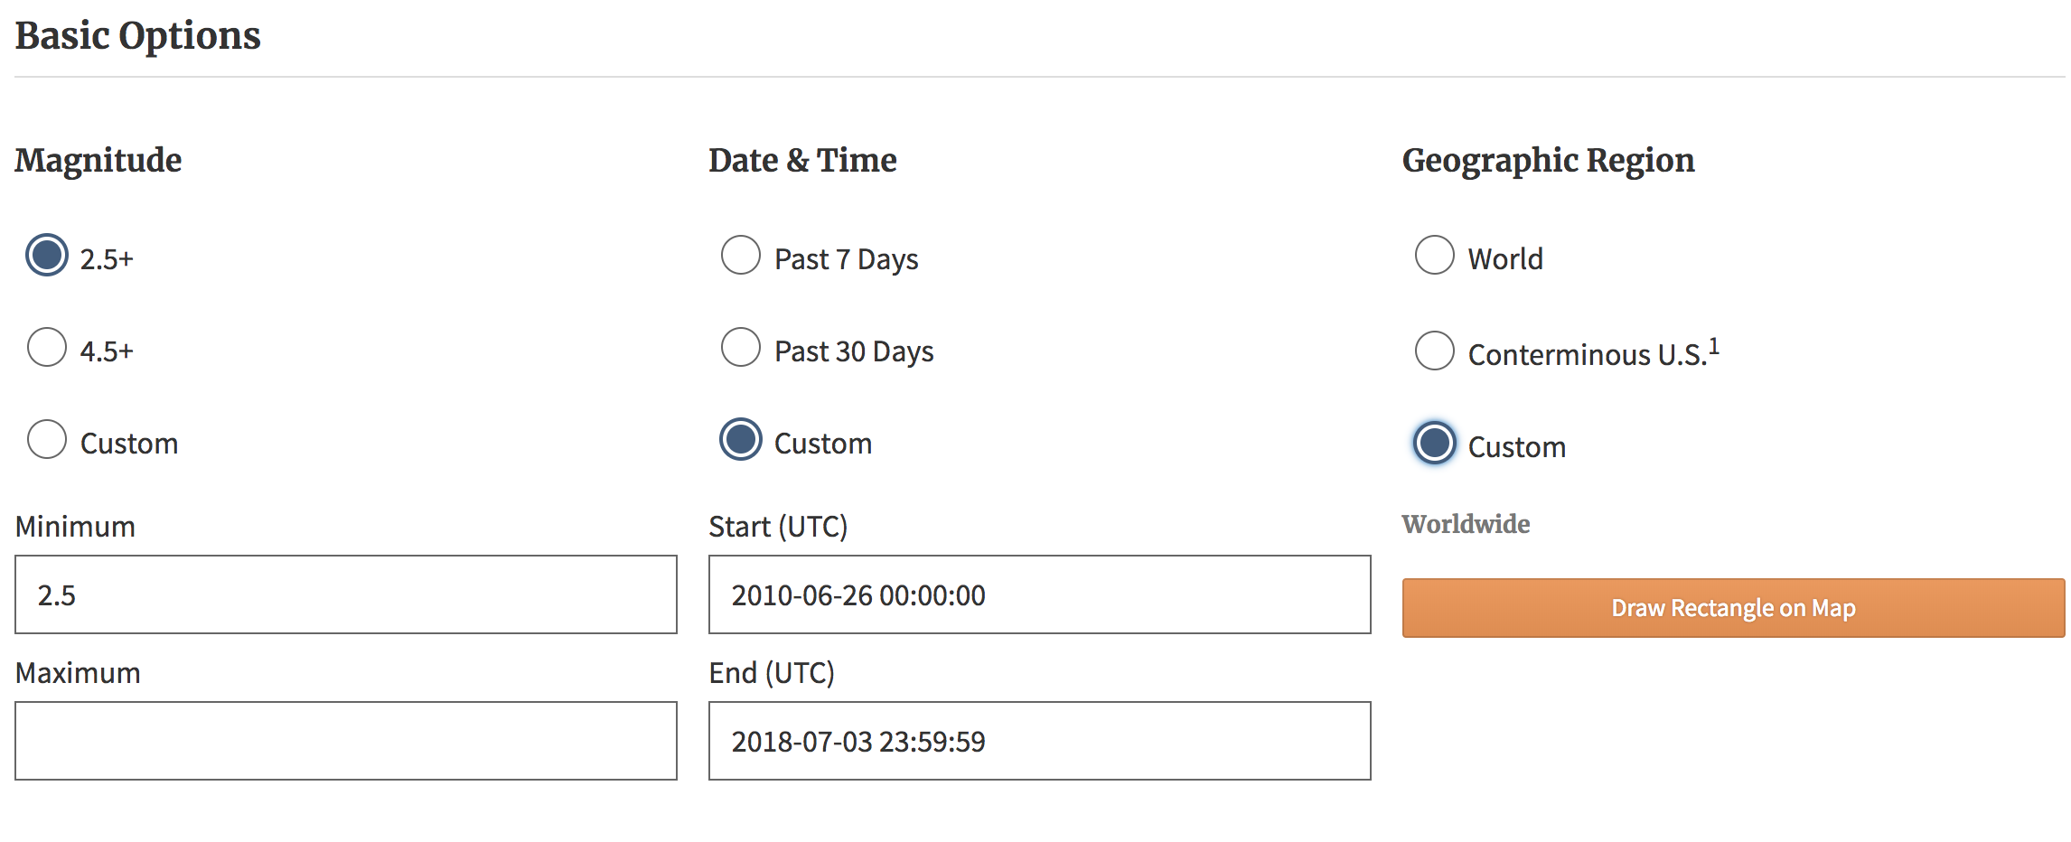
Learning as we go

Slide 14
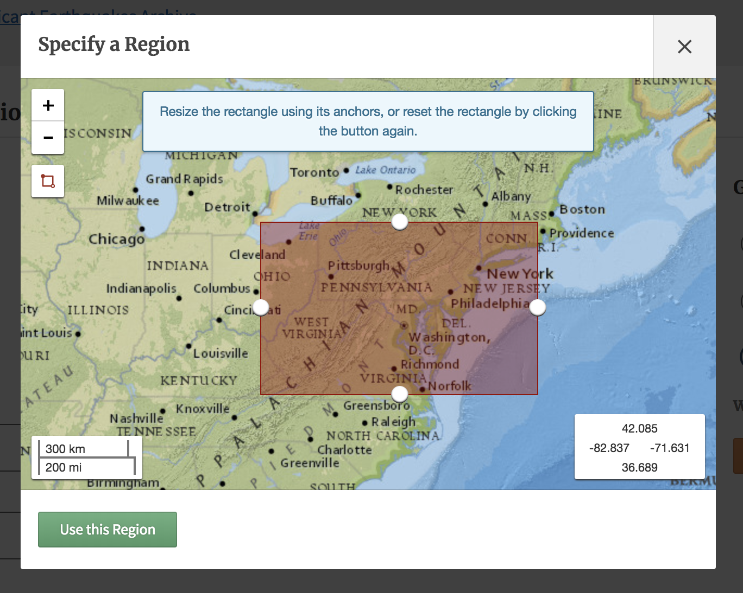
Learning as we go

Slide 15
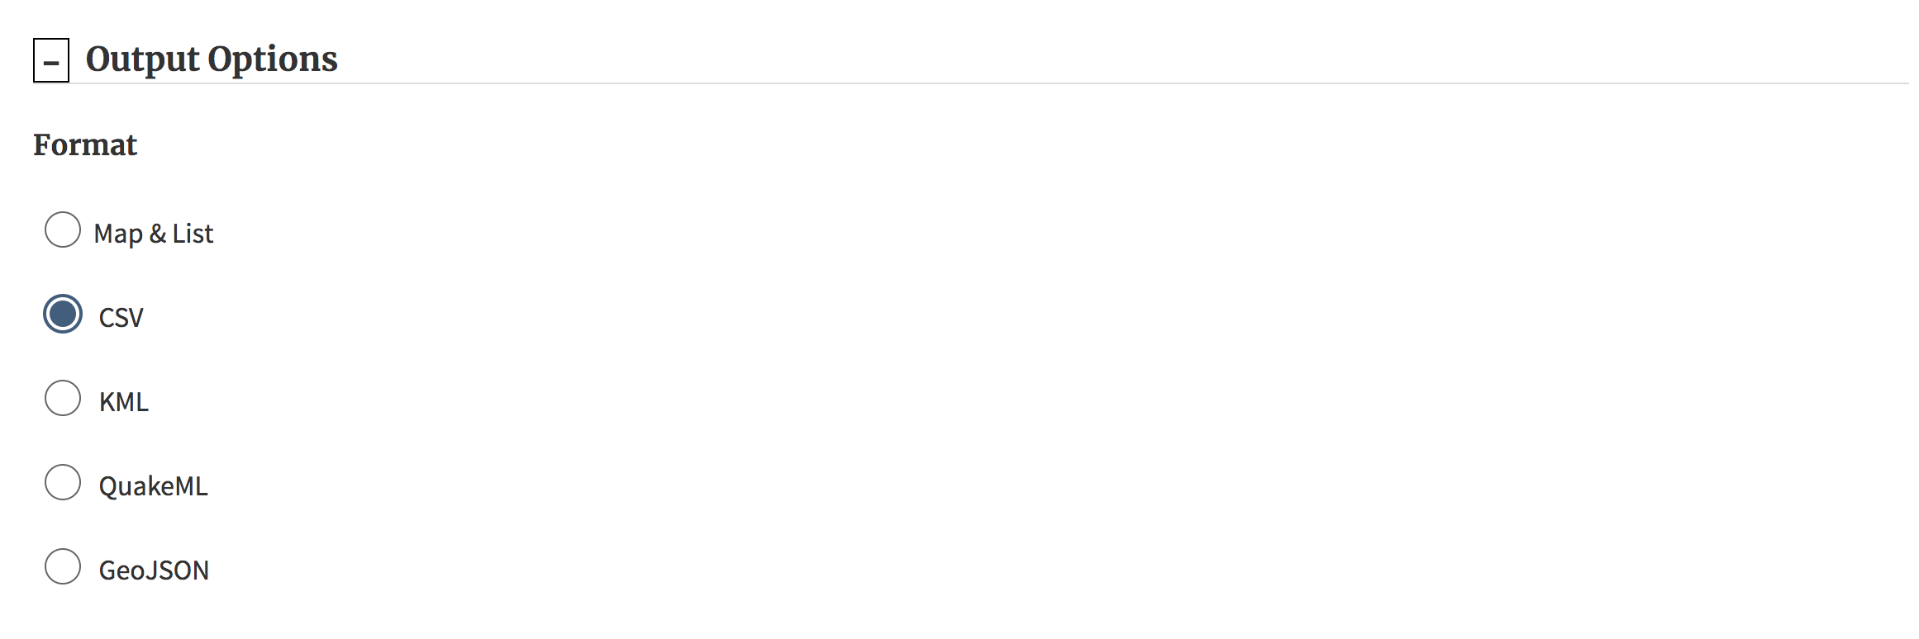
Learning as we go

Slide 16
Learning as we go

Slide 17

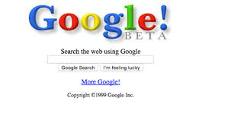
How do we know where to turn?
You have two VERY valuable assets

Slide 18

How do we know where to turn?
Notes:
Lots of good data… but be skeptical

Slide 19
How do we know where to turn?
Census Bureau – population, race, socio-economic demographics, map shape files, data by various geographies
St. Louis Fed – wide variety of economic data: GDP, time series of other data
Bureau of Labor Statistics – Injuries, recent unemployment, inflation calculations, etc.
Inspectors General for each department, WARN notices, OMB, CBO
Congressional reports

Slide 20
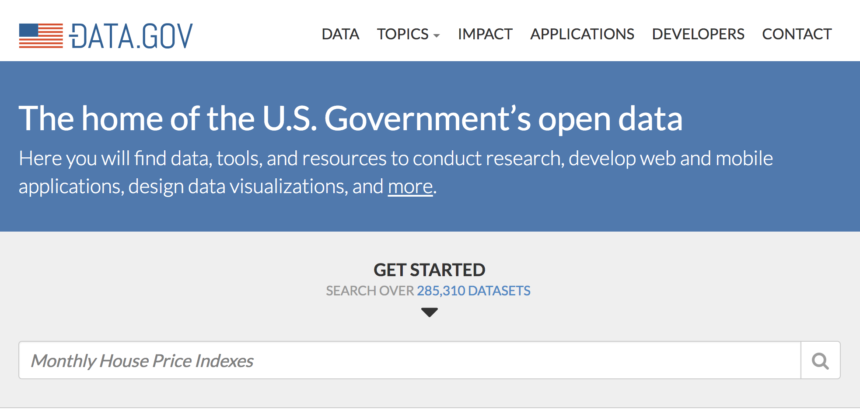
How do we know where to turn?
Notes:
Lots of good data… but be skeptical

Slide 21
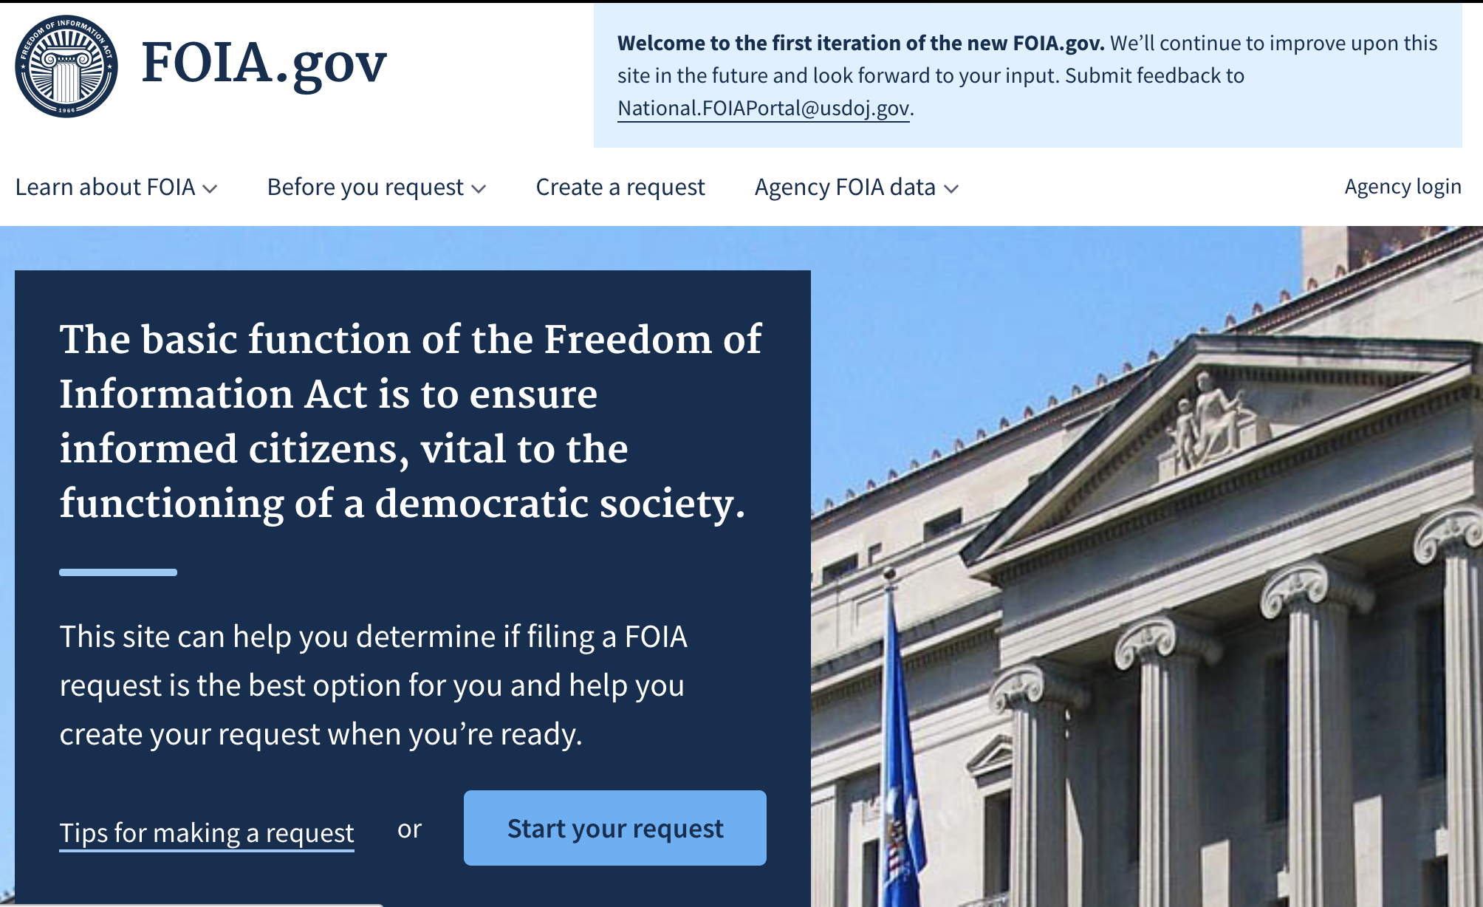
How do we know where to turn?
Notes:
Lots of good data… but be skeptical

Slide 22
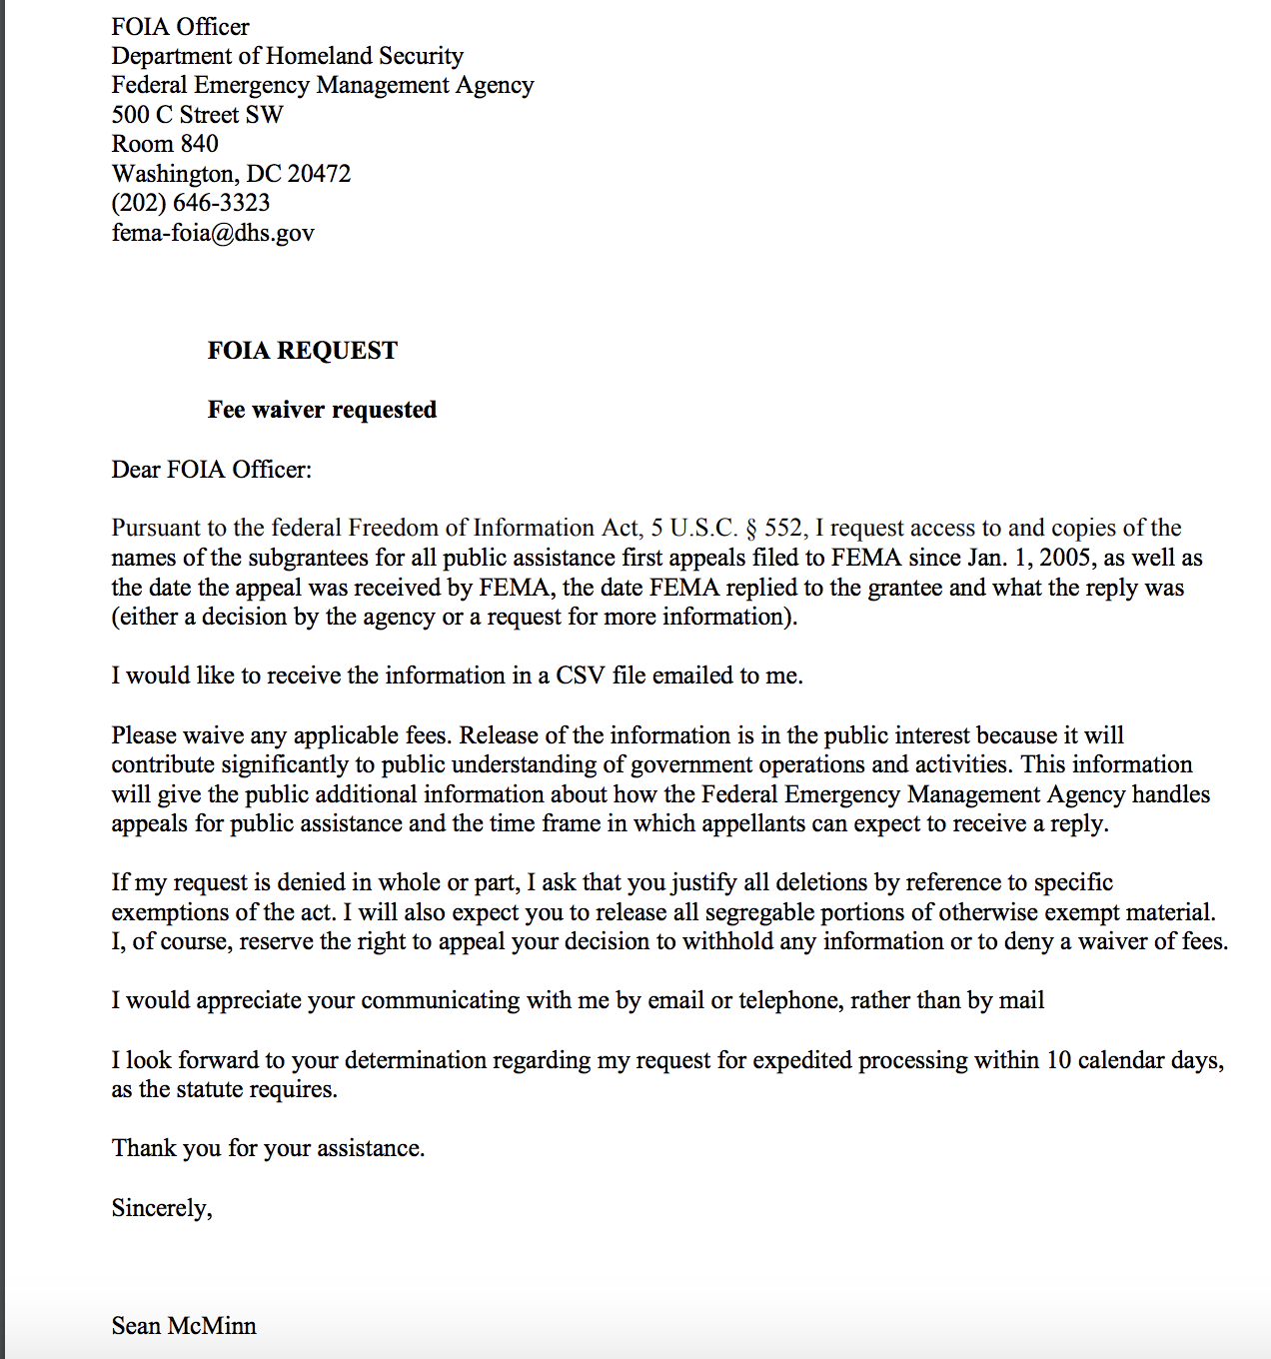
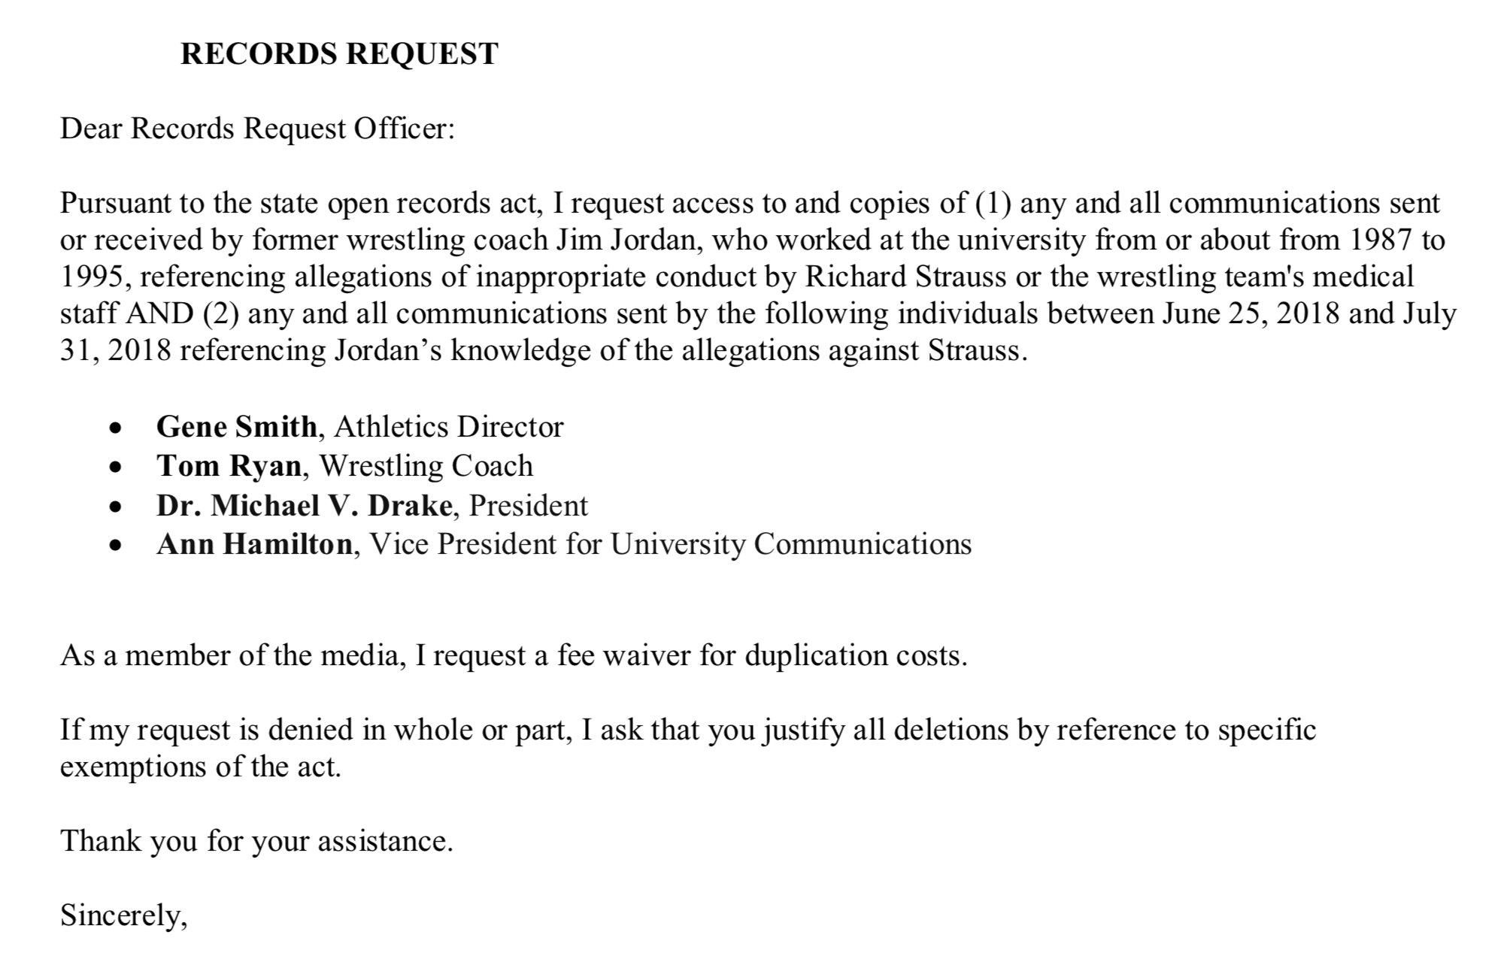
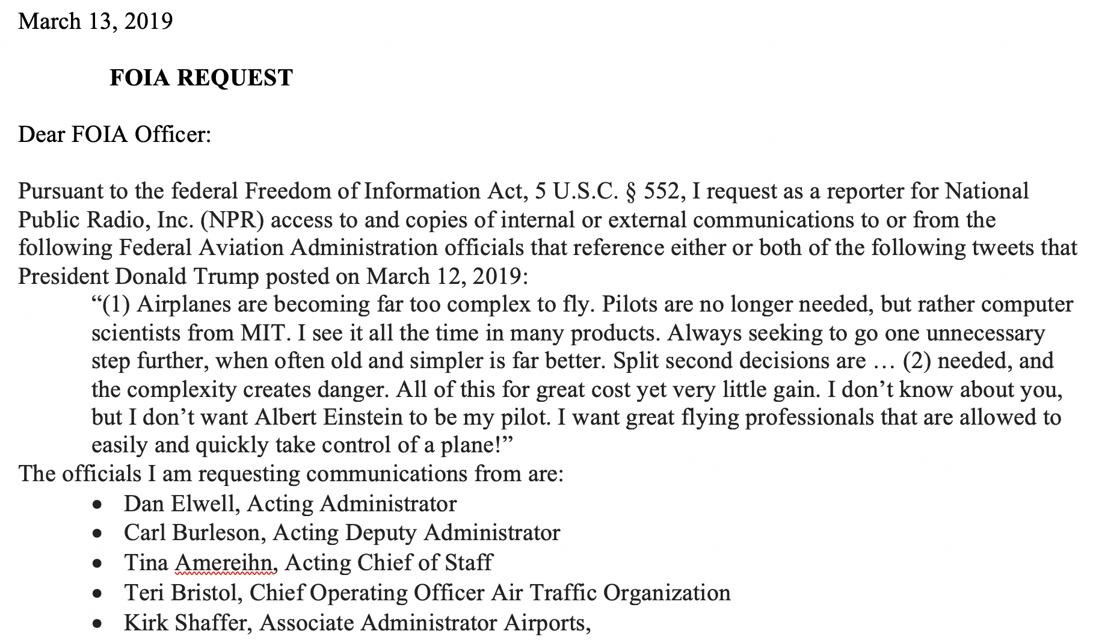
How do we know where to turn?
Notes:
Lots of good data… but be skeptical

Slide 23
Other places to find data
Non-profits (ProPublica, Pew, OpenSecret, GuideStar, National Conference of State Legislatures etc.)
Think tanks (Rand, Brookings, etc.)
Academics (CSIS, Harvard, etc.)
Congressional hearings
Third parties (FlightAware, Cuebiq, etc.)

Slide 24
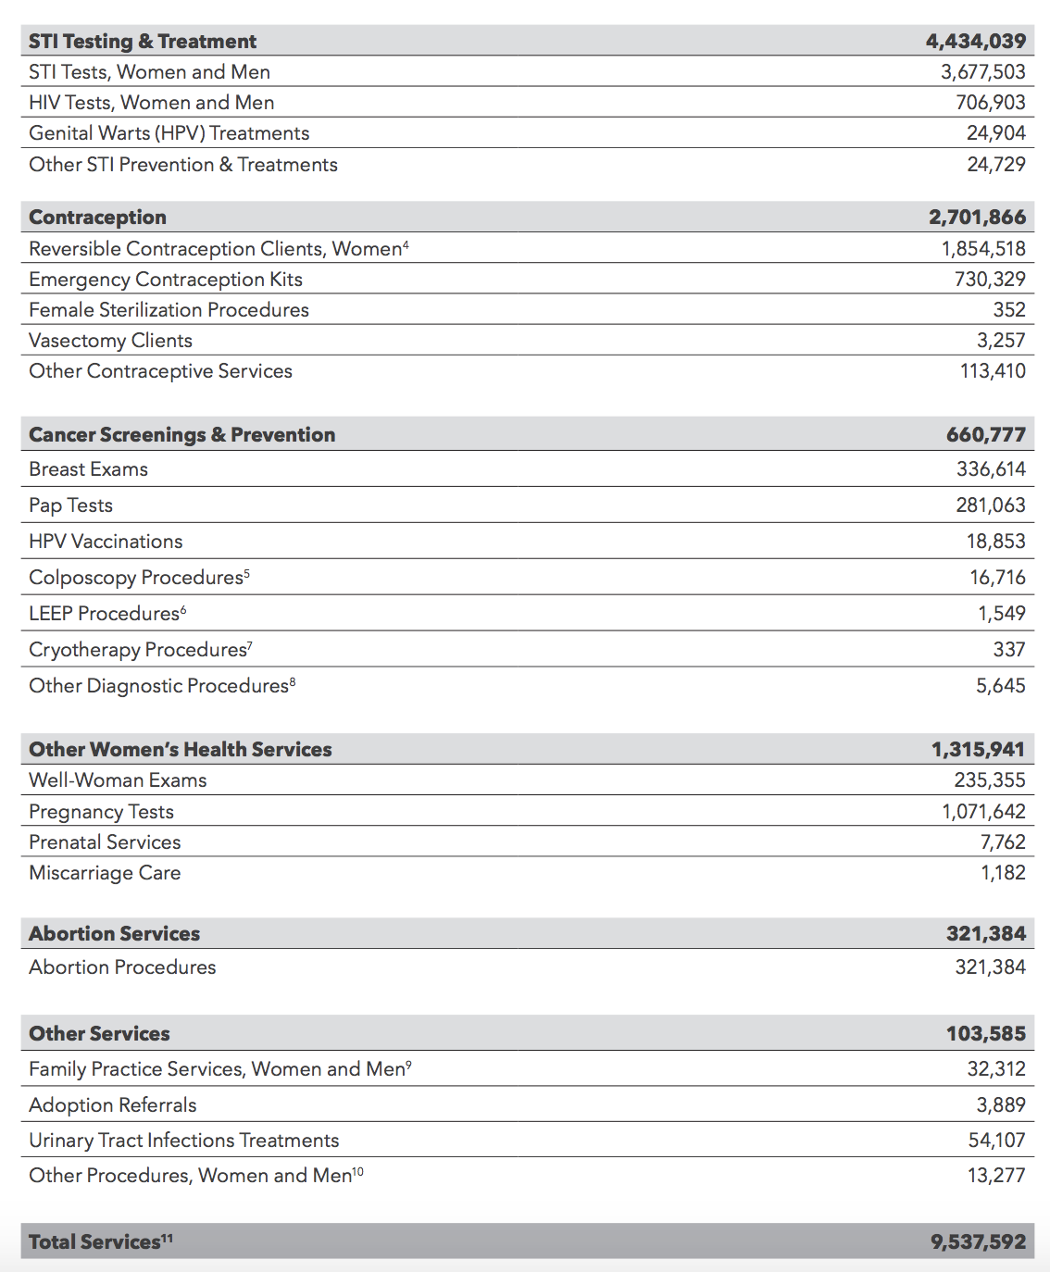

Other places to find data
Reports

Slide 25
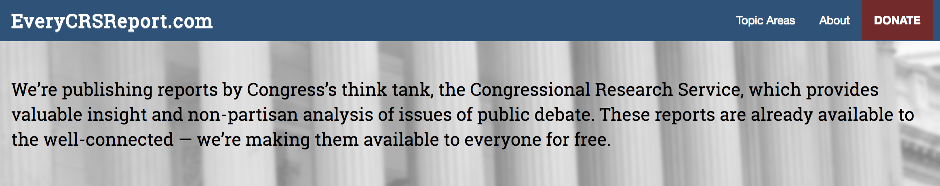

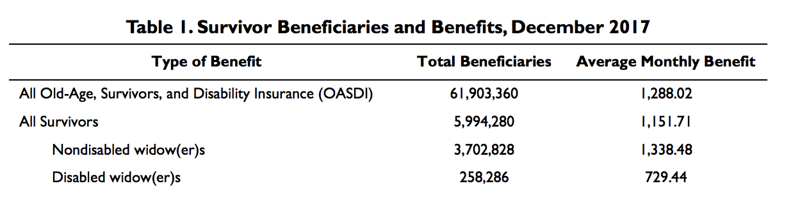
Other places to find data
CRS – Nonpartisan research for Congress

Slide 26
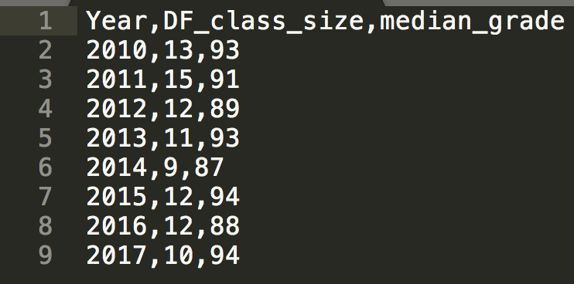
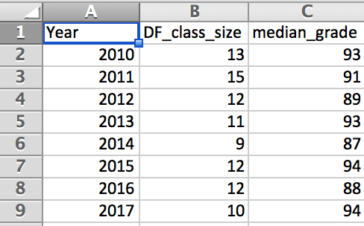
Data types
CSV: comma separated values
Very accessible for reporters
Readable in Excel, Tableau, R, Python, etc.

Slide 27
Data types
XML: eXtensible markup language
Human and machine readable
Available by API, site feeds

Slide 28
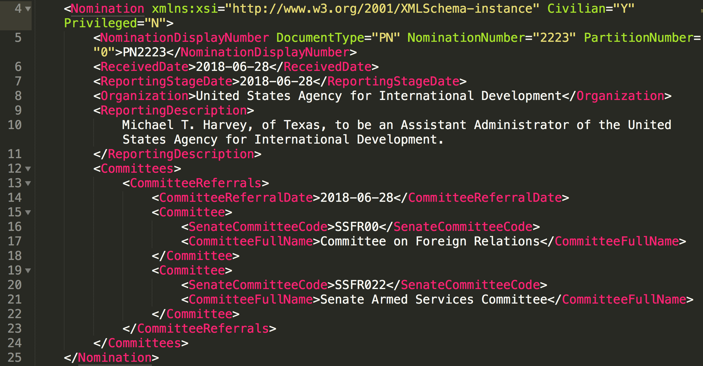
Data types

Slide 29
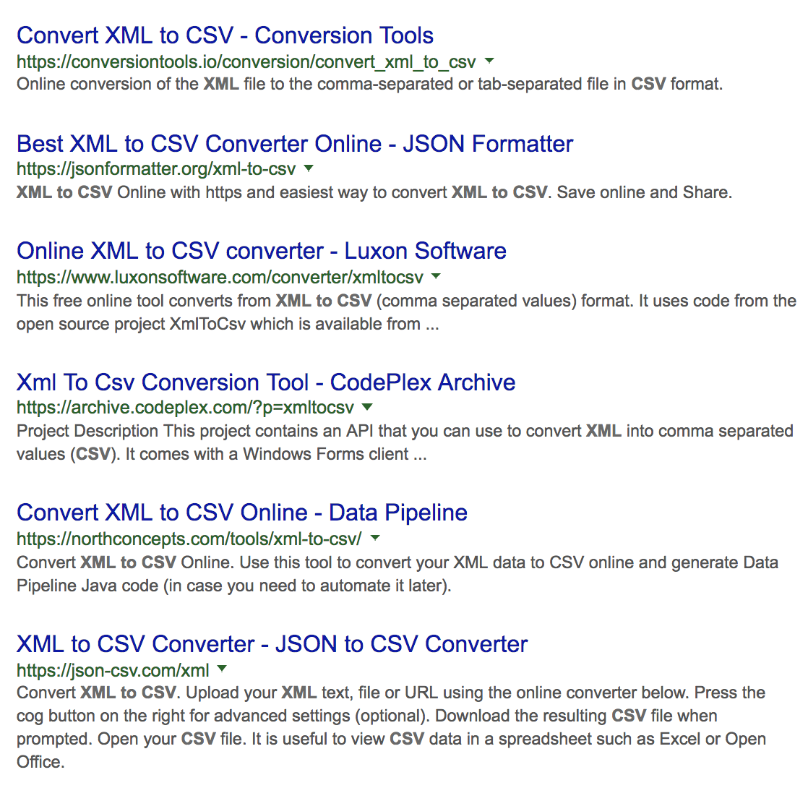
Data types
For XML, sometimes it’s best to just convert to CSV

Slide 30
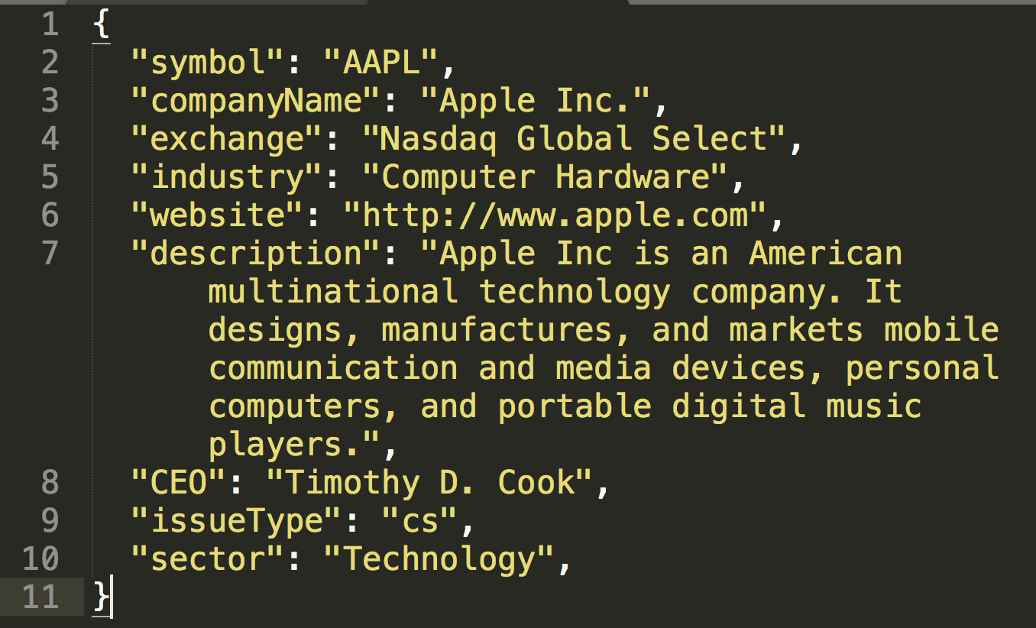
Data types
JSON: JavaScript Object Notation
Comes from APIs, ready-to-use in JavaScript

Slide 31
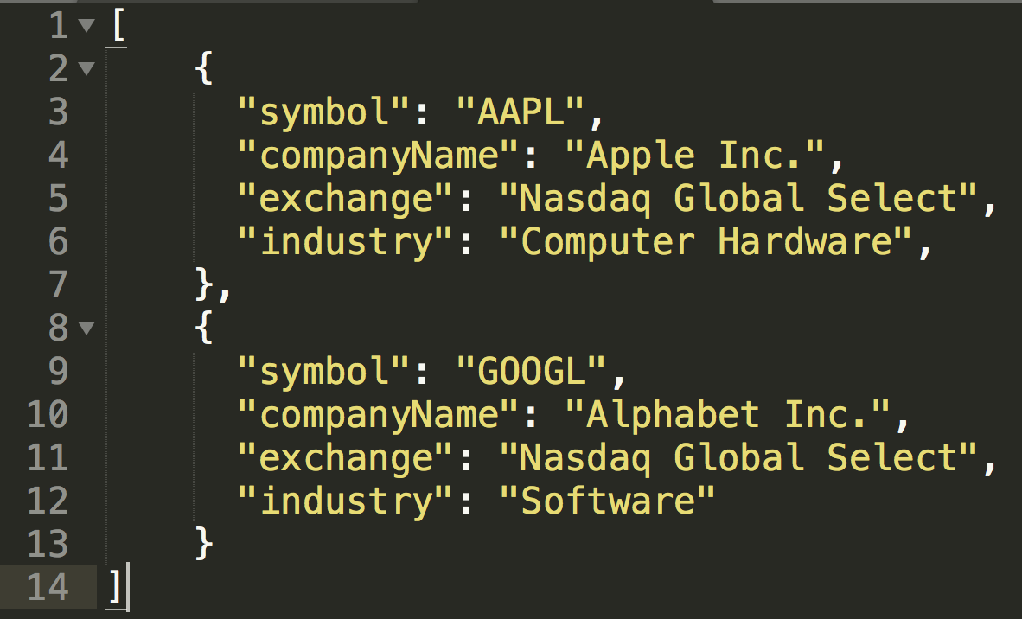
Data types
Multiple JSON objects can be put together in an array (like rows in a spreadsheet)

Slide 32
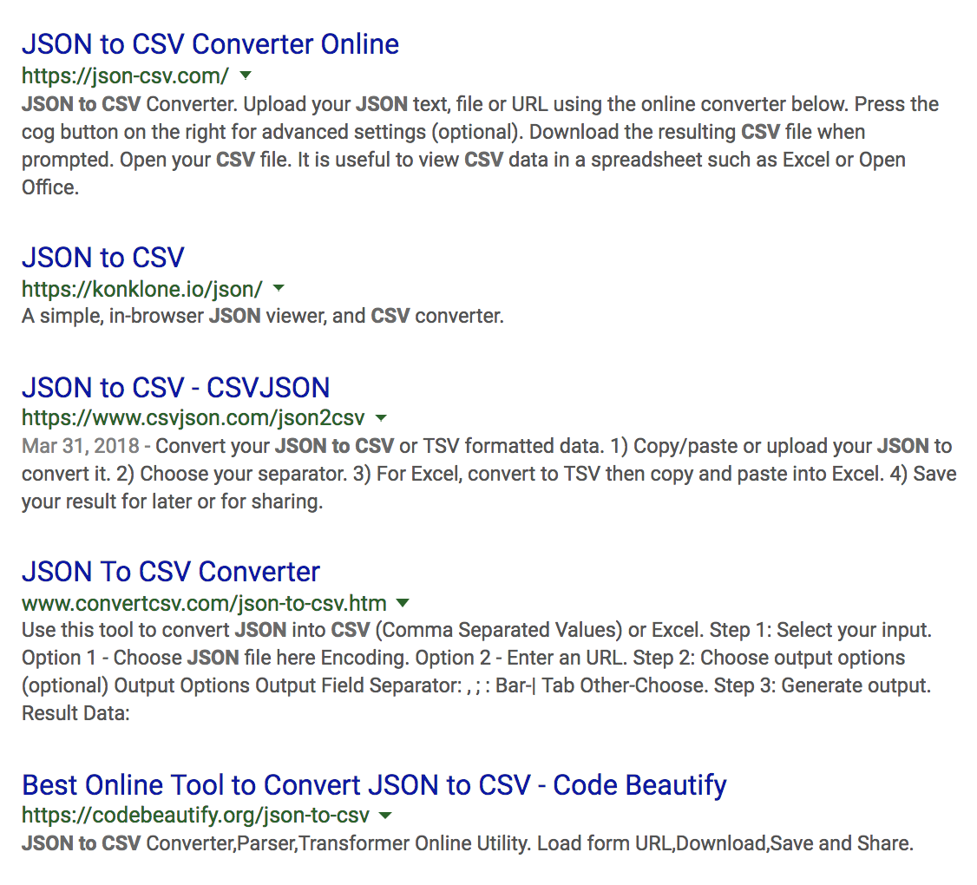
Data types
And just like XML, you can convert these into CSVs, too

Slide 33
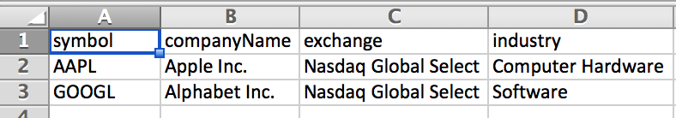
Data types
So this =>
Becomes this =>

Slide 34
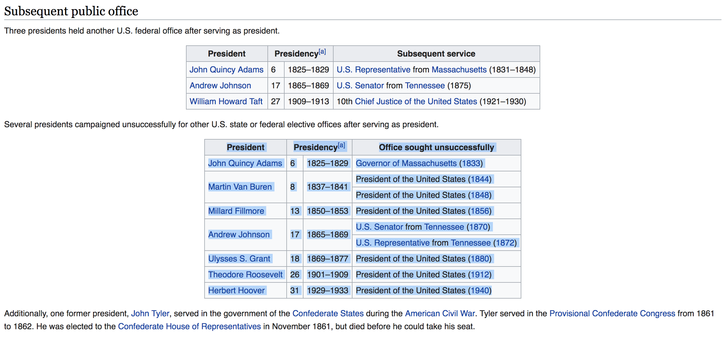
Data types
HTML
If a download isn’t available, you can check to see if the data is on the web page itself

Slide 35
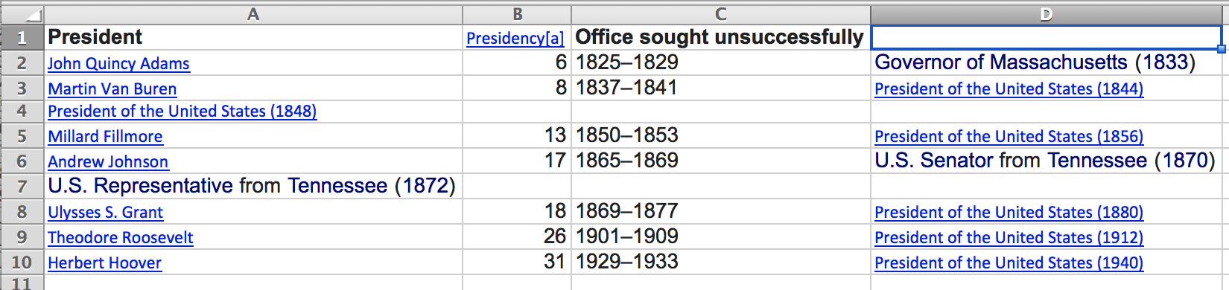
Data types
HTML
If a download isn’t available, you can check to see if the data is on the web page itself

Slide 36
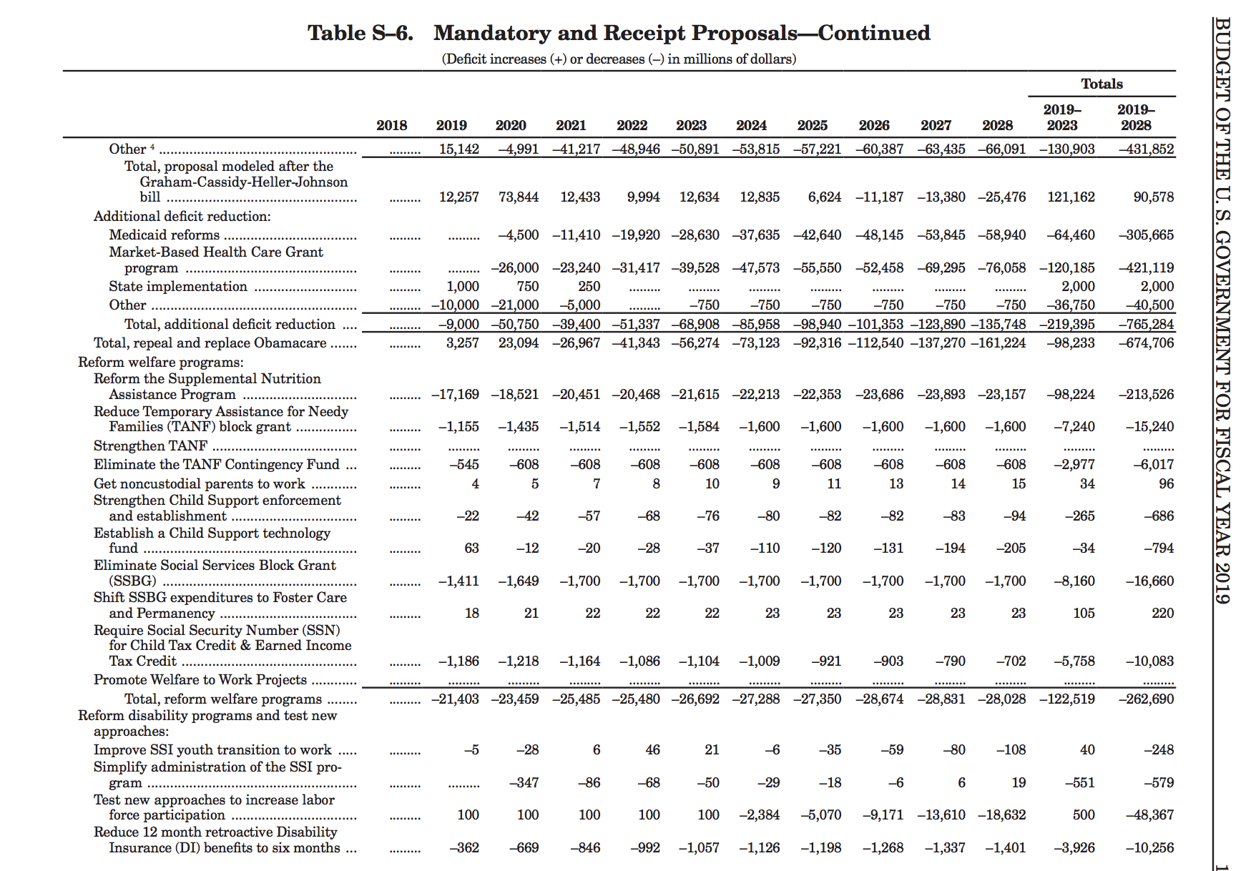


Data types
PDF

Slide 37
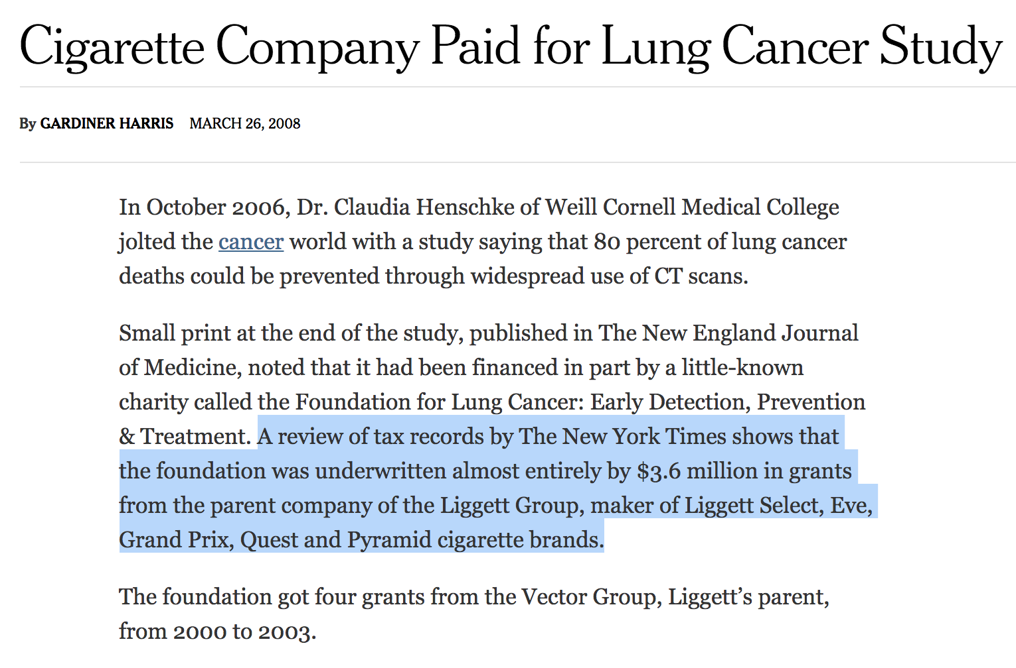
Thinking critically
Notes:
Who’s behind it?

Slide 38
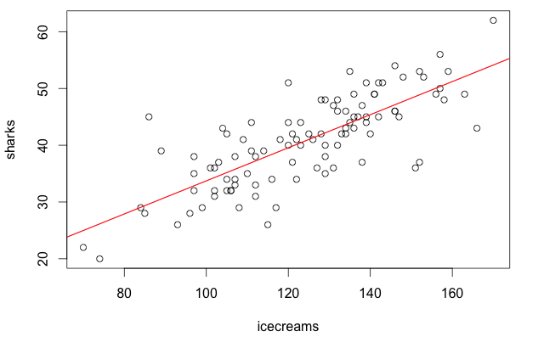
Thinking critically
Notes:
What’s missing?

Slide 39
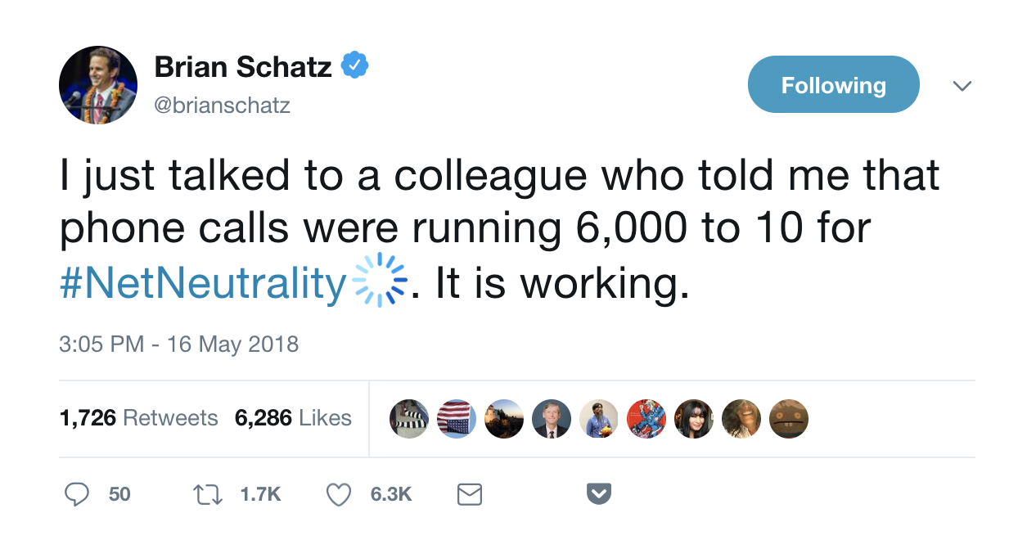
Thinking critically
Notes:
Can you view the underlying data?

Slide 40
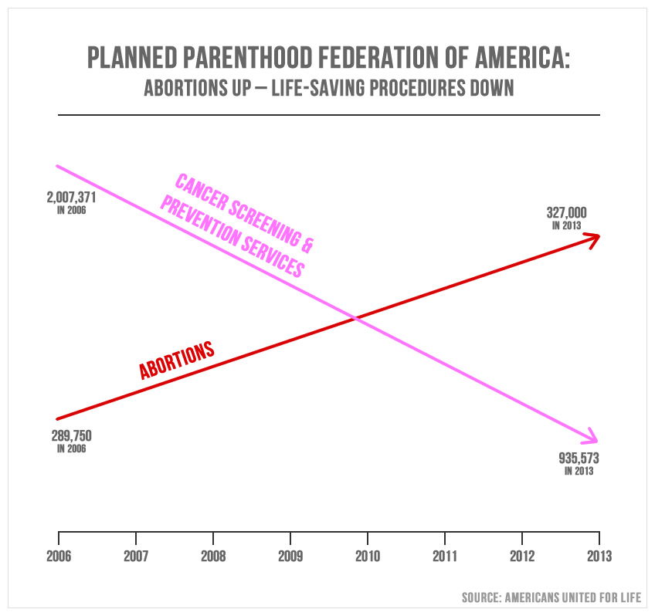
Thinking critically

Slide 41
Thinking critically
Who’s behind it?
Americans United for Life is an American pro-life public interest law firm and advocacy group based in Washington, D.C.: Wikipedia
Utah Republican Jason Chaffetz presented in committee hearing
What’s missing?
Accurate scale
Data between 2006 and ‘13
Underlying data set
Yes!

Slide 42
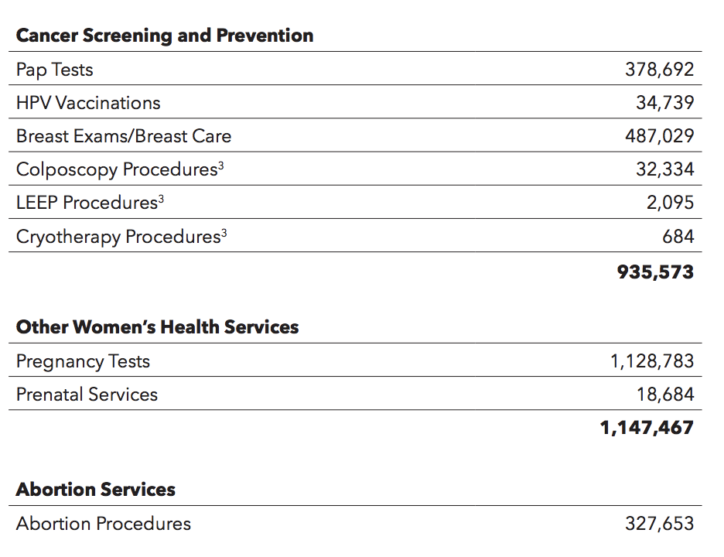
Thinking critically

Slide 43
Thinking critically
Get the data about the data
Who created it?
Who is responsible for maintaining it?
What point in time or time-range does it apply to?
How was the data collected?
How was the data processed after being collected?
How was each field collected or calculated?
http://training.npr.org/visual/what-to-do-with-a-big-pile-of-data/

Slide 44
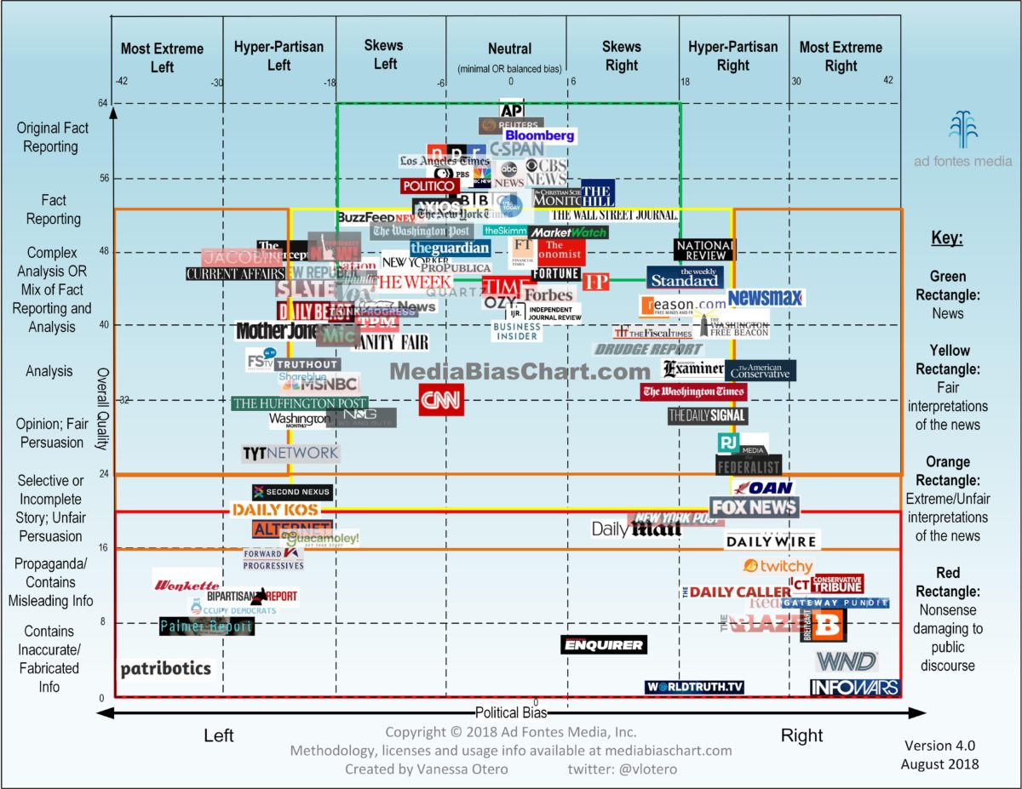
Thinking critically
https://www.adfontesmedia.com/

Slide 45
Thinking critically
In pairs:
Find a dubious dataset or data-driven claim
Evaluate why it may not be credible AND who may stand to gain from it
See if credible publicly available data can confirm or contradict it
Present findings to class

Slide 46
Making your own database
What are you collecting?
Trickier than it sounds: be specific!
Start question: Who’s getting the most endorsements in the 2020 primary?
More detail: Are there regional trends? Trends over time? Does it matter more if a state lawmaker, for example, endorses than if a mayor does?

Slide 47
Making your own database
Think about data you might need down the road — not always obvious
For endorsements:
Time/date
Location
Level of seniority
Public address vs statement? Which TV channel?

Slide 48
Making your own database
Questions that may pop up:
Does it count if someone says they’re voting for X, but doesn’t use the word “endorse”?
What if someone switches their endorsement?
Answer these kinds of questions as soon as possible

Slide 49
Making your own database
Where can you get your “data”?
Original documents
Surveys
Sensors
Photos/videos
News reports
Observations

Slide 50
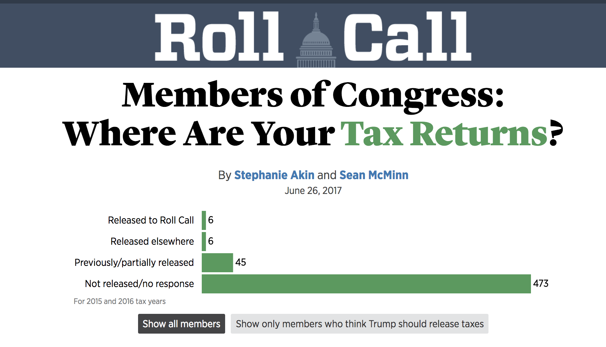
Making your own database

Slide 51
Making your own database
unique_key
member
state_ap_abbrv
party
Chamber
tax_return_status
trump_should_release
previous_trump_comment
prev_comment_source
leadership
document_link
document_src
Trump_notes
tax_notes
last_name
update_date

Slide 52
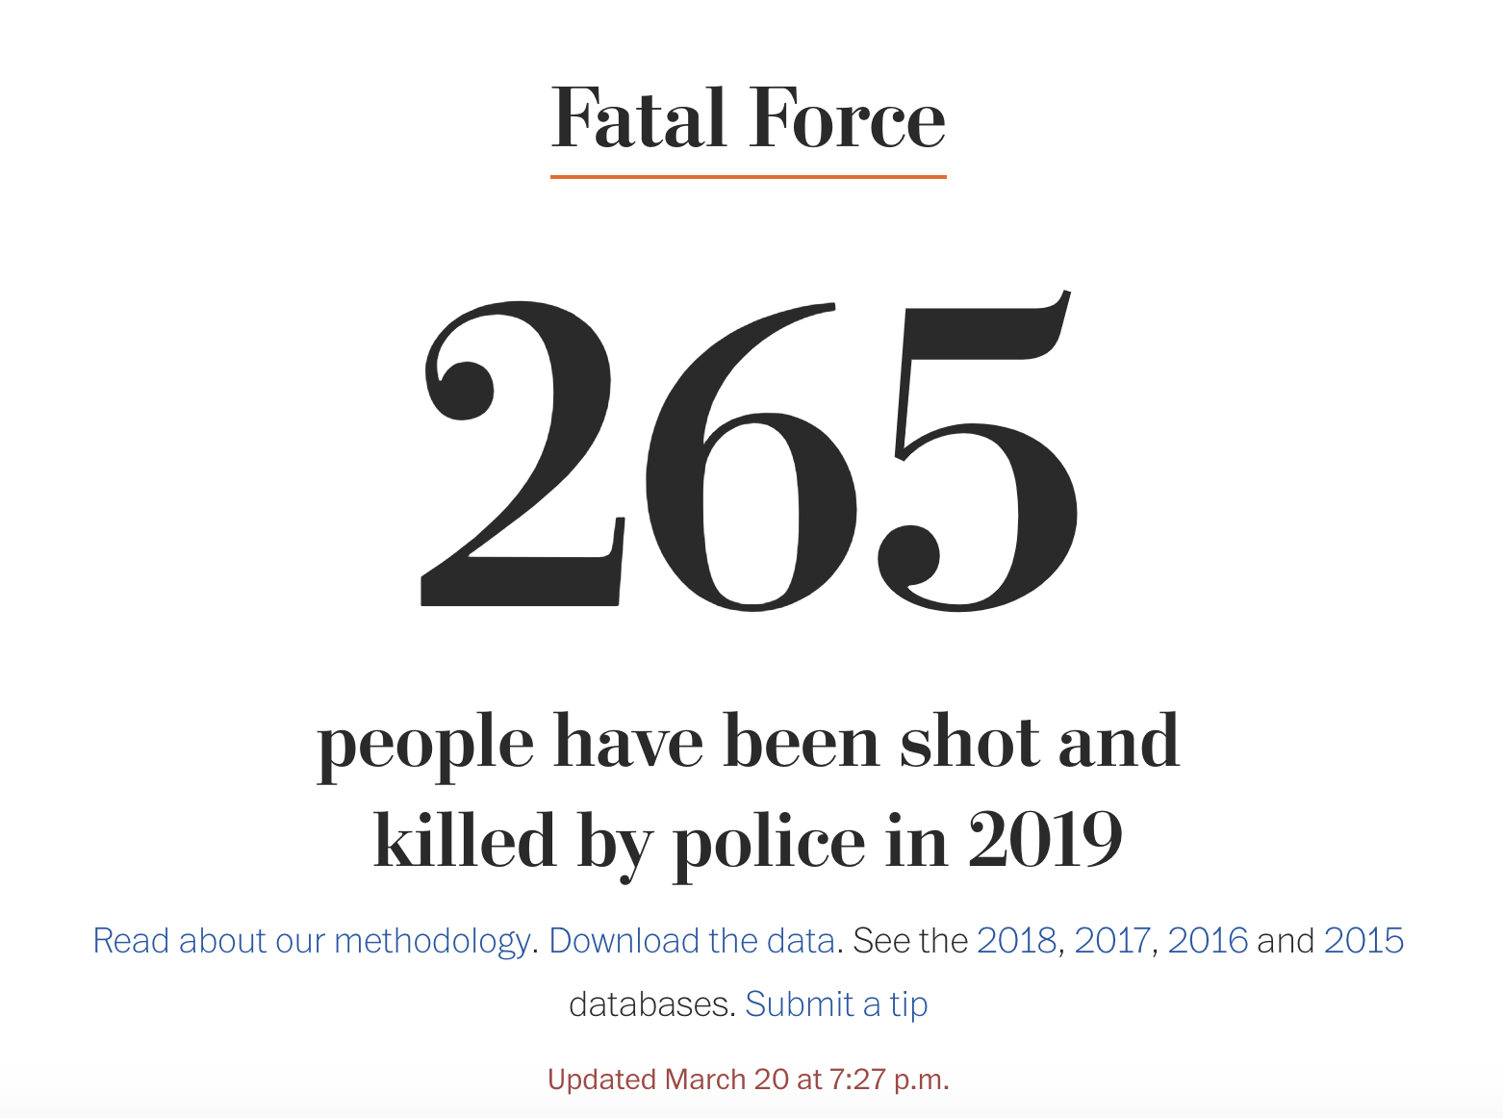
Making your own database

Slide 53
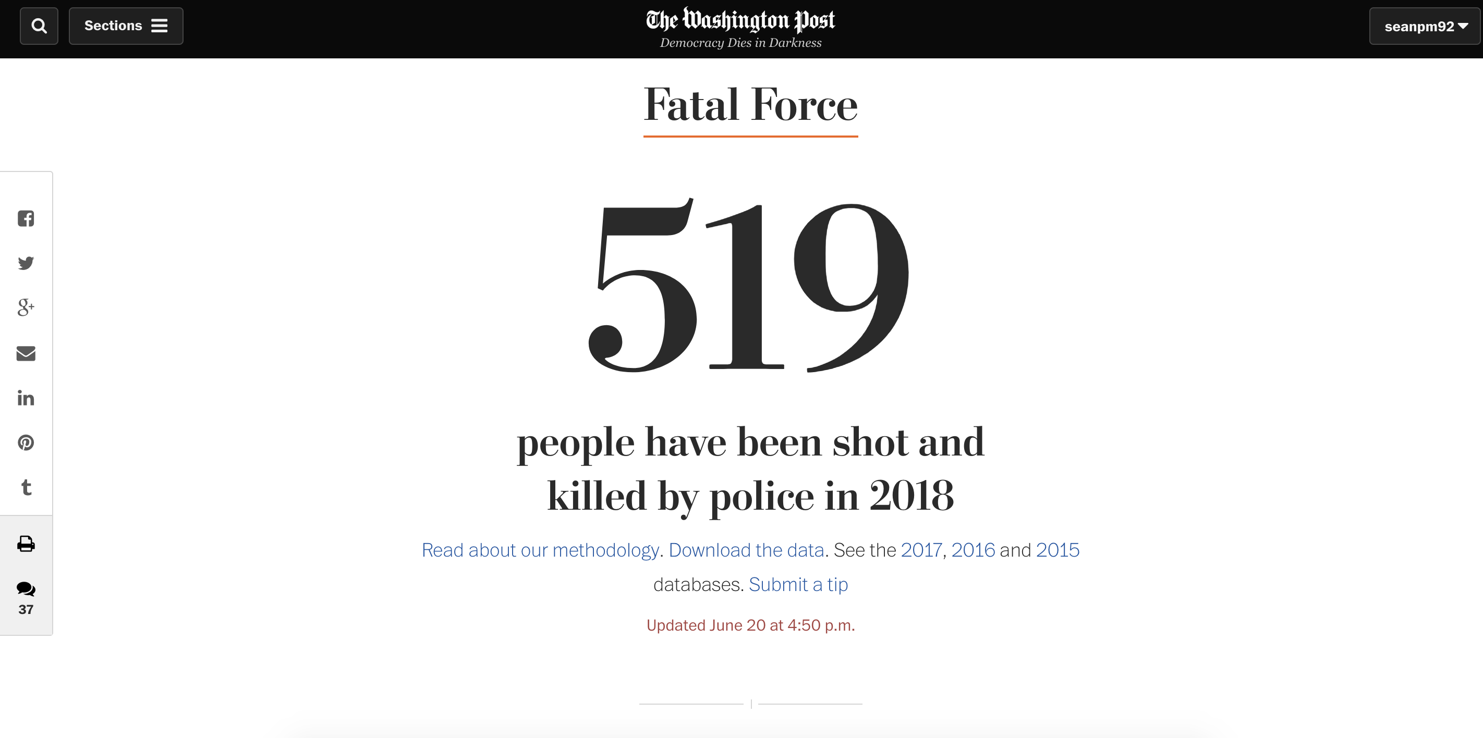
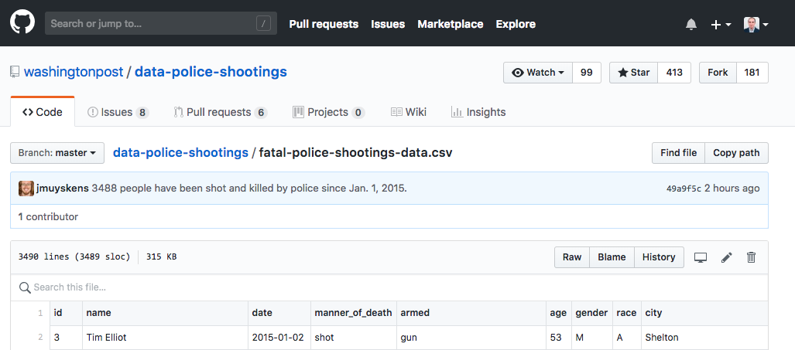
Making your own database

Slide 54
Making your own database
WHILE WE’RE HERE
Let’s download the dataset on github
github.com/washingtonpost/data-police-shootings

Slide 55

Making your own database

Slide 56
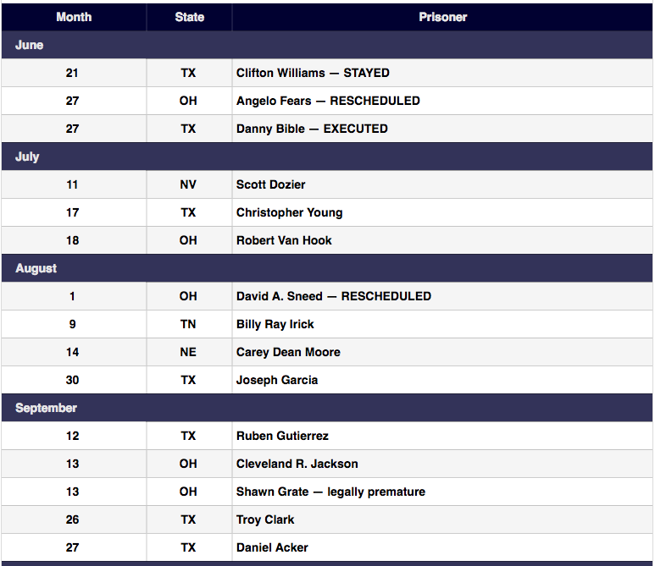
Making your own database

Slide 57
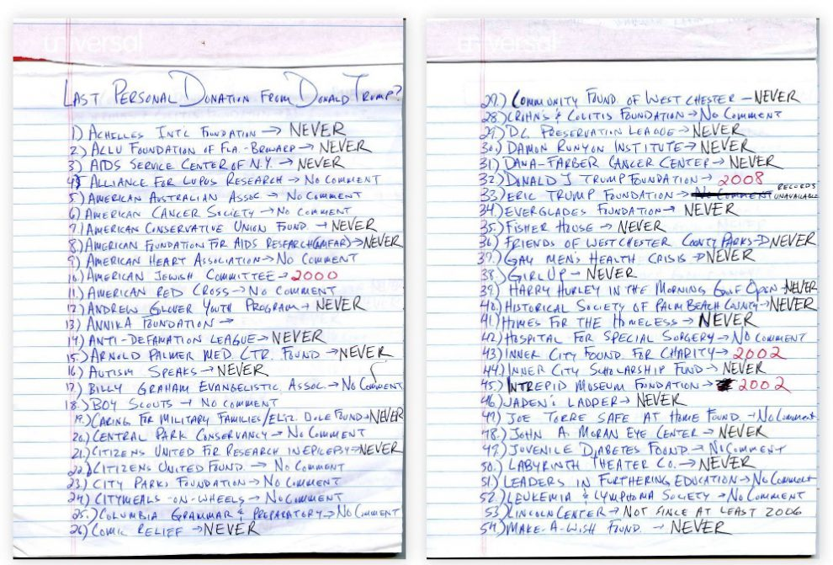
Making your own database

Slide 58

Making your own database

Slide 59
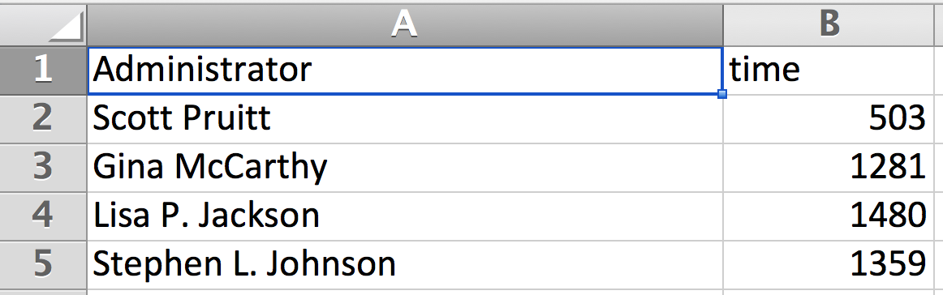
Making your own database
Treat each row as an “observation” or “individual”
Data should generally be “tall,” not “fat”
☺
☹

Slide 60
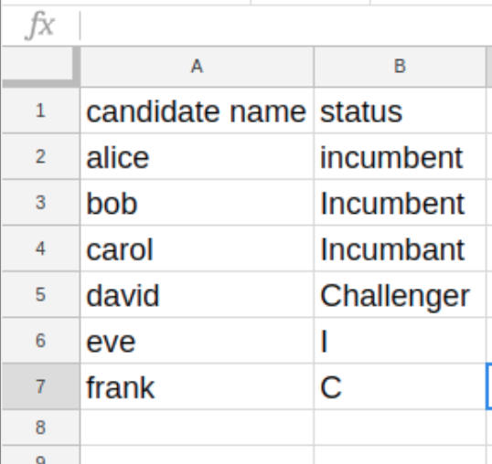
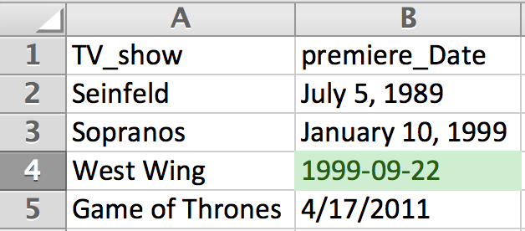
Making your own database
Be consistent … consistently!
☹
☹

Slide 61
Assignment
Think about an area you're interested in, or one you may do your final project on, and come up with a dataset you wish existed.
https://github.com/randyleonard99/digitalframeworks-spring2020/blob/master/class3/assignment3.md

